Slide 1

cad
#3

Slide 2
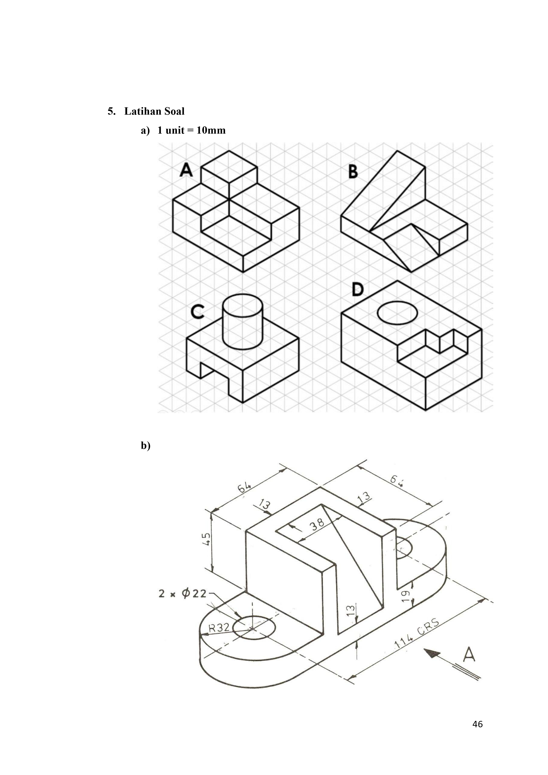
Gambar 1

Slide 3
Gambar 2

Slide 4
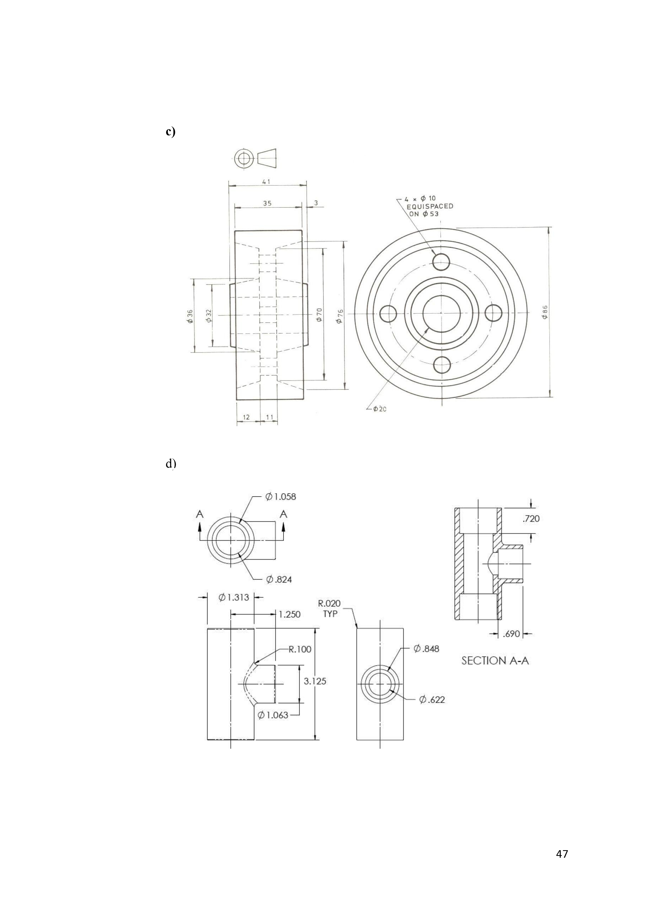
Gambar 3

Slide 5
Gambar 4

Slide 6

Thank you
- baren

